Slide 1


A Trillion Cell Spreadsheet
Mihai Budiu – VMware Research Group (VRG)
September 24, 2019
Parikshit Gopalan, Lalith Suresh, Udi Wieder, Marcos Aguilera – VMware Research
Han Kruiger –University of Utrecht, intern at VRG

Slide 2


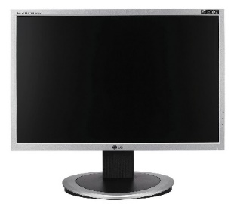
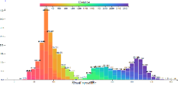
Browsing big data
Interactive visualization of billion row datasets
Slice and dice data with the click of a mouse
No coding required
Mihai Budiu, Parikshit Gopalan, Lalith Suresh, Udi Wieder, Han Kruiger, and Marcos K. Aguilera, Hillview: A trillion-cell spreadsheet for big data, in PVLDB 2019, 12(11)
http://github.com/vmware/hillview
Apache 2 license

Slide 3




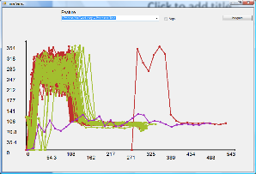
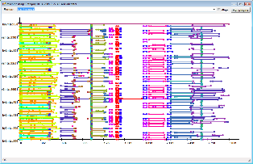
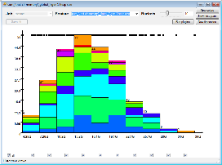
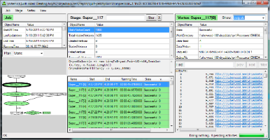
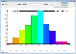
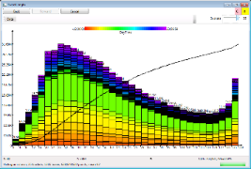
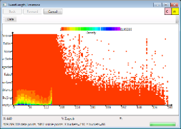
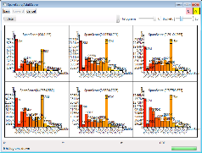
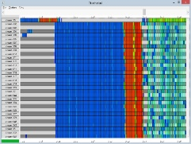

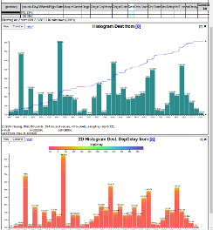
History
2006 | Dryad (Eurosys 2007) deployed by Microsoft Live Search
2008 | DryadLINQ (OSDI 2008); Artemis DryadLINQ job profiler (WASL 2008)
2011 | Daphne DryadLINQ job debugger (HIPS 2011); Fay distributed safe tracing (SOSP 2011)
2014 | Sketch spreadsheet (EGPGV 16)
2016
2019 | (VLDB 19)
MSR
VRG

Slide 4


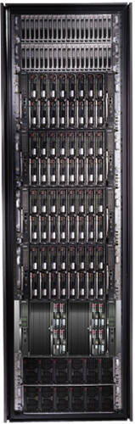
Bandwidth hierarchy
These channels are lossy!
Compute approximate data views with an error < channel error.

Slide 5
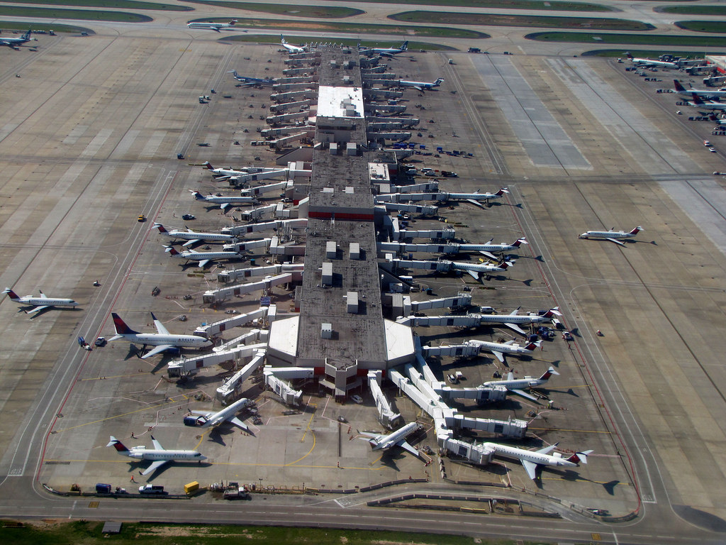
Demo
Real-time video
Browsing a 140 million
.5M flights/month
All US flights in last 23 years
Public data from FAA website
Running on 15 small VMs in Amazon’s cloud (6GB heap size, 2 CPU cores each)
Video: https://1drv.ms/v/s!AlywK8G1COQ_jeRQatBqla3tvgk4FQ
Demo: http://ec2-18-217-136-170.us-east-2.compute.amazonaws.com:8080/

Slide 6
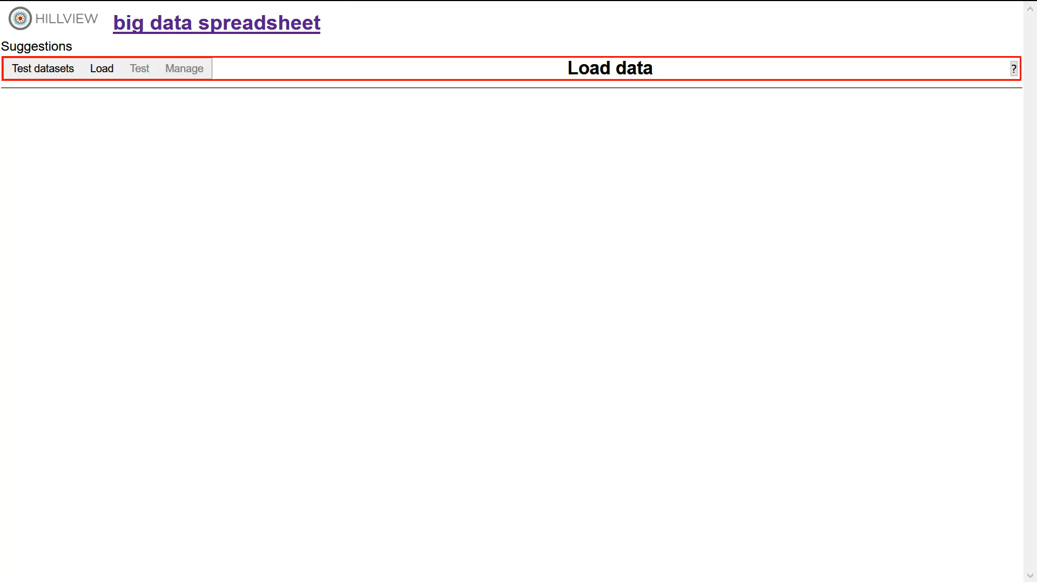
Video

Slide 7
Talk outline
Motivation
Fundamental building blocks
System architecture
Visualization as sketches
Evaluation
Conclusion

Slide 8
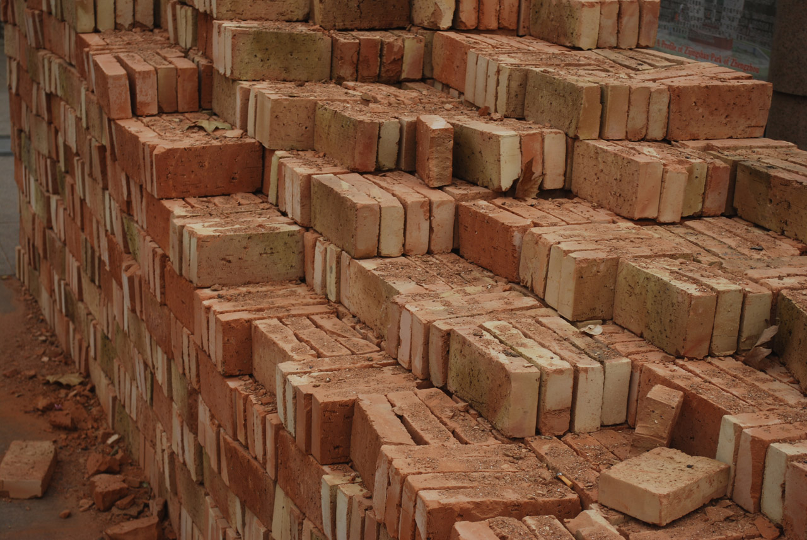
Hillview Building Blocks

Slide 9

Monoids
A set M with
An operation + : M x M -> M
Associative: (a + b) + c = a + (b + c)
A distinguished zero element: a + 0 = 0 + a = a
Commutative if a + b = b + a
interface IMonoid<R> { R zero(); R add(R left, R right);
}

Slide 10
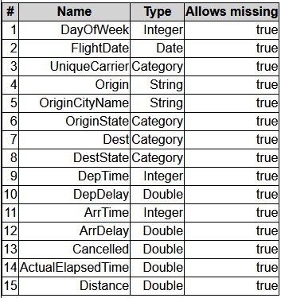
Abstract Computational Model
Output O
Post
processing
sketch (vizketch)
R must be “small”
(independent on N,
dependent on screen size)
R
add
R
R
add
add
R
R
R
R
Streaming/ sampling algorithm
summarize
summarize
summarize
summarize
Input data, sharded
Multi-set of N tuples

Slide 11
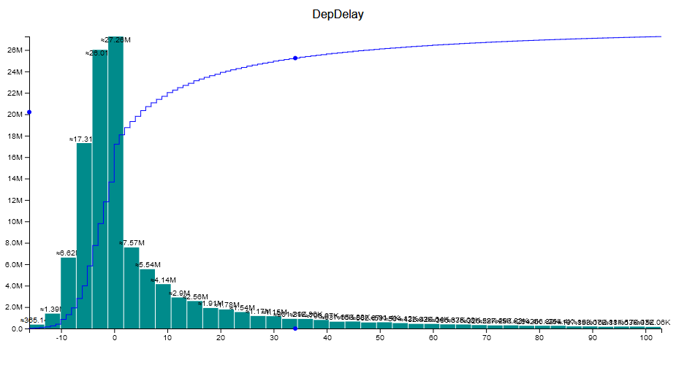
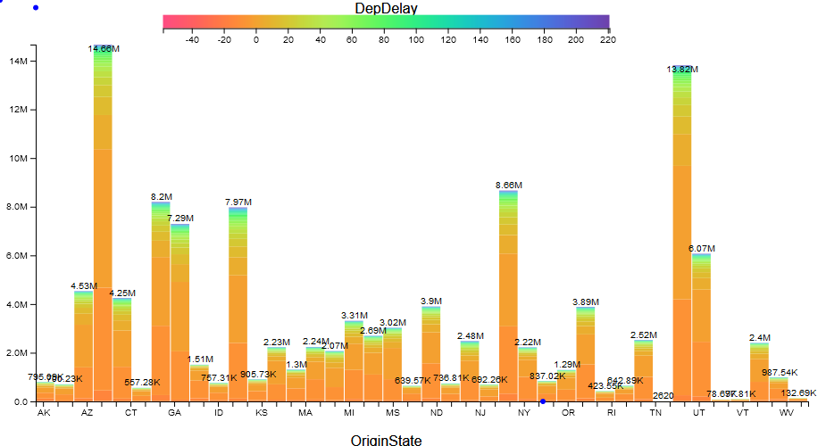
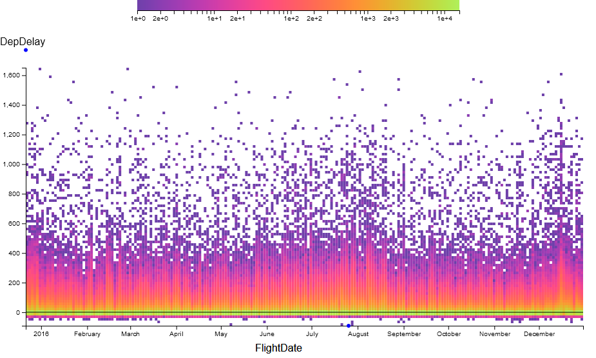
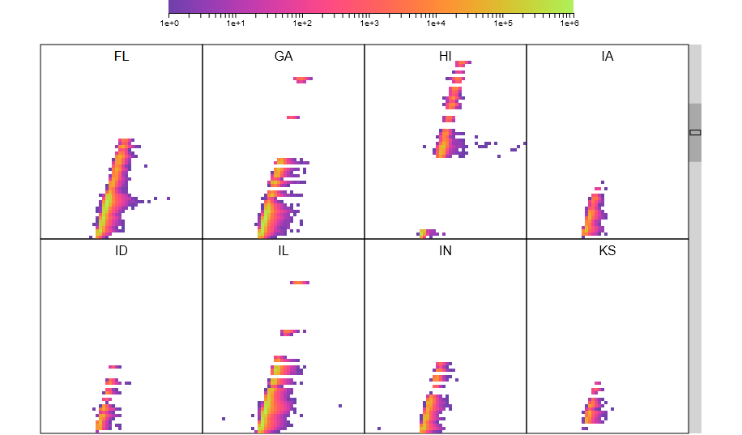
All views are produced by vizketches!

Slide 12
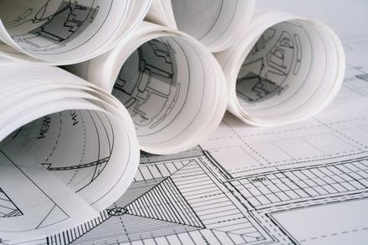
System architecture

Slide 13
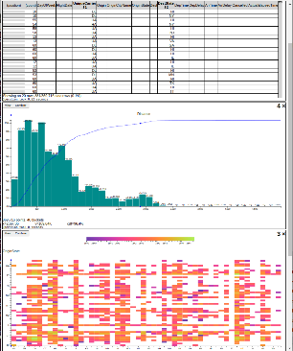


Hillview System architecture
workers
Leaf
node
In-memory
table
Parallel
snapshot
read
Aggregation
node
Leaf
node
In-memory
table
Web front-end
Root
node
In-memory
table
Storage
Leaf
node
In-memory
table
request
In-memory
table
Storage
Remote tables refs.
Aggregation
node
Leaf
node
In-memory
table
streaming
response
In-memory
table
Storage
Redo log
In-memory
table
Client
web browser
Storage
Aggregation network
Hillview cloud service
Deploy Hillview where your data is.

Slide 14
Immutable Partitioned Objects
browser
handle
root node
Address spaces
Network
IDataSet<T>
T
T
T
T
T
T
T
T
T
T
T
Workers

Slide 15

DataSet Core API
interface ISketch<T,R> extends IMonoid<R> { R summarize(T data); }
interface PR<T> { // Partial result T data; double done; }
interface IDataSet<T> { Observable<PR<R>> sketch(ISketch<T,R> sk); … map(…); … zip(…); }

Slide 16
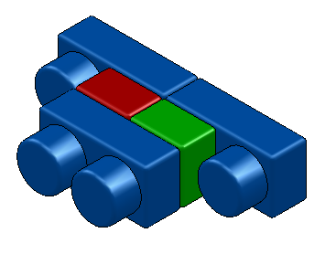
Dataset objects
Implement IDataSet<T>
Identical interfaces on top and bottom
Can be stacked arbitrarily
Modular construction of distributed systems
IDataSet
interface

Slide 17
LocalDataset<T>
Contains a reference to an object of type T in the same address space
Directly executes operations (map, sketch, zip) on object
Local
T

Slide 18
ParallelDataset<T>
Has a number of children of type IDataSet<T>
Dispatches operations to all children
sketch adds the results of children
Parallel

Slide 19
RemoteDataset<T>
Has a reference to an IDataSet<T> in another address space
The only component that deals with the network
Built on top of GRPC
Client
Remote
ref
GRPC
Server

Slide 20
A distributed dataset
Root node
Parallel
Remote
Remote
Network
worker 0
ref
worker 1
ref
ref
worker n
Parallel
Parallel
Remote
Parallel
Parallel
Local
Local
Local
Local
Local
Local
T
T
Rack 0
T
T
T
Rack r
T

Slide 21
map(f)
Remote
Remote
Parallel
Parallel
Local
Local
Local
Local
T
T
S
S
f
f

Slide 22
sketch(s)
interface ISketch<T,R> extends IMonoid<R> { R summarize(T data); }
R
Remote
s.add
R
Parallel
R
R
Local
Local
T
T
s.summarize

Slide 23
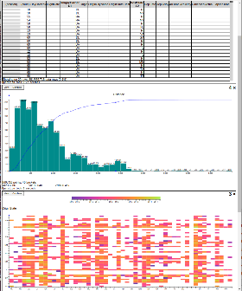
Memory management
Web front-end
Root
node
Leaf
node
In-memory
table
Memoization
cache
Remote tables refs.
In-memory
table
Storage
Redo log
Cache all query-result pairs
Results are always small!
All queries are deterministic
They include the random seed
Random seed gen by client

Slide 24
Memory management
Web front-end
Root
node
Leaf
node
In-memory
table
Memoization
cache
Remote tables refs.
In-memory
table
Storage
Redo log
Soft state (cache)
Log = lineage of all datasets
JSON messages received from client

Slide 25
Bootstrapping
empty object
Local
-
Remote
Parallel
---
log
Local
-
root
workers

Slide 26
Loading: map(load)
Local
-
Remote
Parallel
load
T
Storage
---
Local
map(load)
Remote
Parallel
log
Local
-
load
T
Storage
Local

Slide 27
Filtering: map(filter)
Local
-
Remote
Parallel
Local
T
---
filter
map(load)
Remote
Parallel
Local
S
map(filter)
log
Local
-
Remote
Remote
Parallel
Local
T
filter
Local
S

Slide 28
Crash + restart worker – or – GC on worker
Local
-
Remote
Parallel
Local
T
---
map(load)
Remote
Parallel
Local
S
map(filter)
log
Local
-
Remote
Remote
Parallel
crash

Slide 29
Fault tolerance
Local
-
Remote
Parallel
Local
T
---
map(load)
Remote
Parallel
Local
S
map(filter)
log
sketch
Local
-
sketch
Remote
Remote
Parallel

Slide 30
Detect missing data
Local
-
Remote
Parallel
Local
T
---
map(load)
Remote
Parallel
result (cached)
Local
S
map(filter)
log
Local
-
Remote
Remote
Parallel
exception

Slide 31
Attempt to replay log
Local
-
Remote
Parallel
Local
T
---
map
map(load)
map
Remote
Parallel
Local
S
replay
map(filter)
log
Local
-
Remote
Remote
Parallel

Slide 32
Replay: source data is missing
Local
-
Remote
Parallel
result (cached)
T
---
Local
filter
map(load)
Remote
Parallel
Local
S
replay
map(filter)
log
Local
-
Remote
Remote
Parallel
exception
filter

Slide 33
Replay: backtrack
Local
-
Remote
Parallel
Local
T
---
replay
map(load)
Remote
Parallel
Local
S
map(filter)
log
Local
-
Remote
Remote
Parallel
load
T
Storage
Local

Slide 34
Replay filter
Local
-
Remote
Parallel
Local
T
---
filter
map(load)
Remote
Parallel
Local
S
replay
map(filter)
log
Local
-
Remote
Remote
Parallel
Local
T
filter
Local
S

Slide 35
Complete original operation
Local
-
Remote
Parallel
Local
T
---
map(load)
Remote
Parallel
Local
S
map(filter)
log
sketch
Local
-
sketch
Remote
Remote
Parallel
Local
T
Local
S

Slide 36
Complete original operation
Local
-
Remote
Parallel
Local
T
---
filter
map(load)
Remote
Parallel
result
Local
S
map(filter)
log
Local
-
Remote
Remote
Parallel
Local
T
filter
result
Local
S

Slide 37

Visualization as sketches

Slide 38
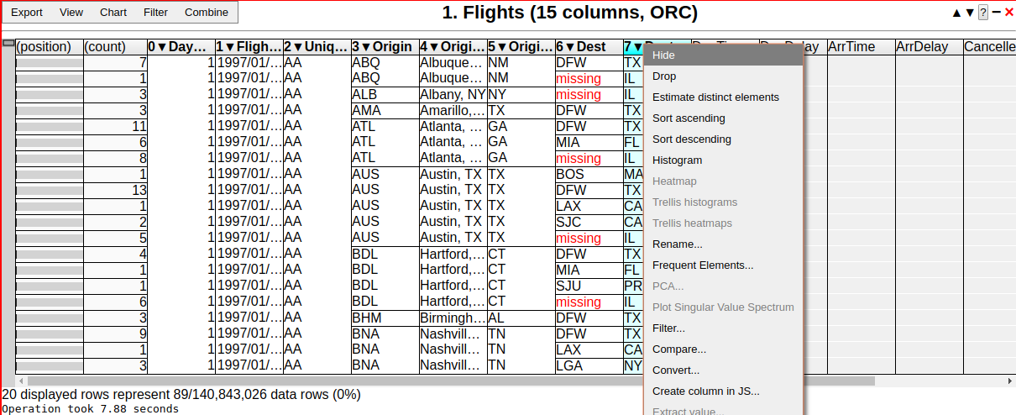
Table views
Always sorted
NextK(startTuple, sortOrder, K)
Monoid operation is “merge sort”

Slide 39
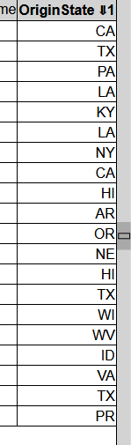
Scrolling
Compute startTuple based on scroll-bar position
Approximate quantile
Samples O(H²) rows; H = screen height in pixels

Slide 40
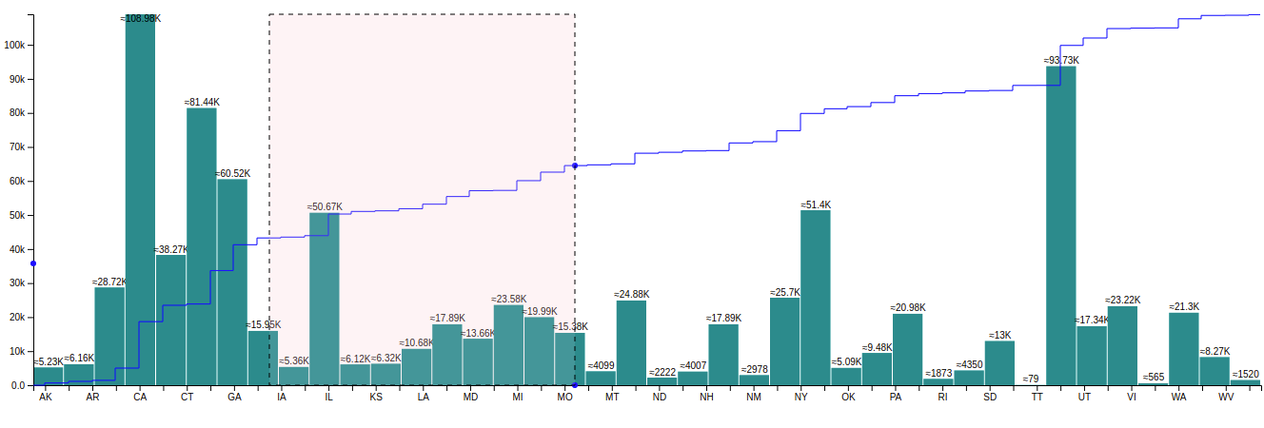
1D Histograms
CDF
Histograms are monoids (vector addition)
CDFs are histograms (at the pixel level)

Slide 41
Histograms based on sampling
Exact histogram
Approximate histogram
μ < 1/2
Actual
Legal rendering
Actual
Legal rendering
Legal rendering
pixel row
Theorem: O((HB / μ)² log(1/δ)) samples are needed to compute an approximate histogram with probability 1 – δ.
H = screen size in pixels
B = number of buckets (< screen width in pixels)
No N in this formula!

Slide 42
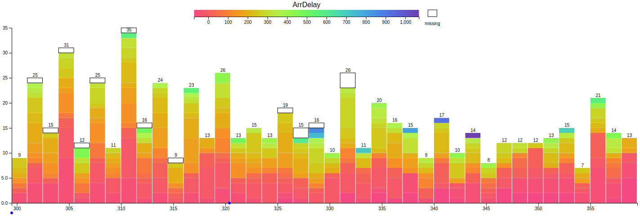
2D Histograms

Slide 43
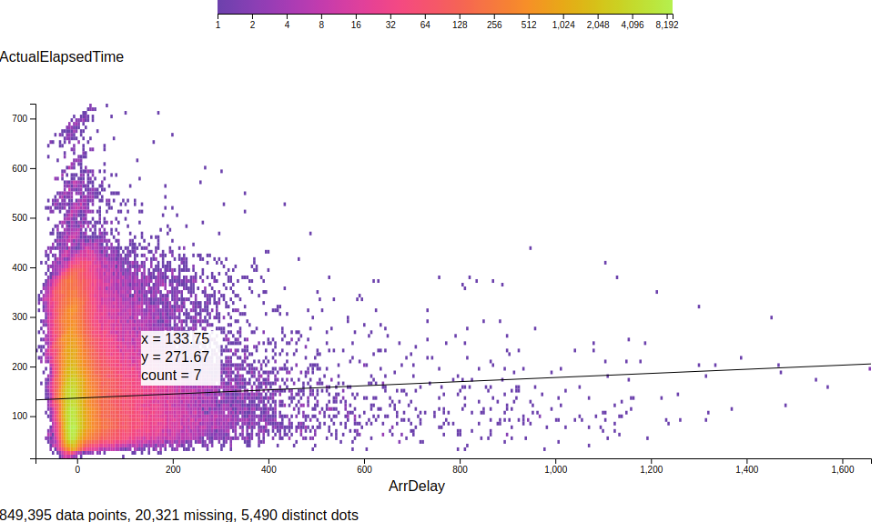
Heatmaps
Linear regression

Slide 44
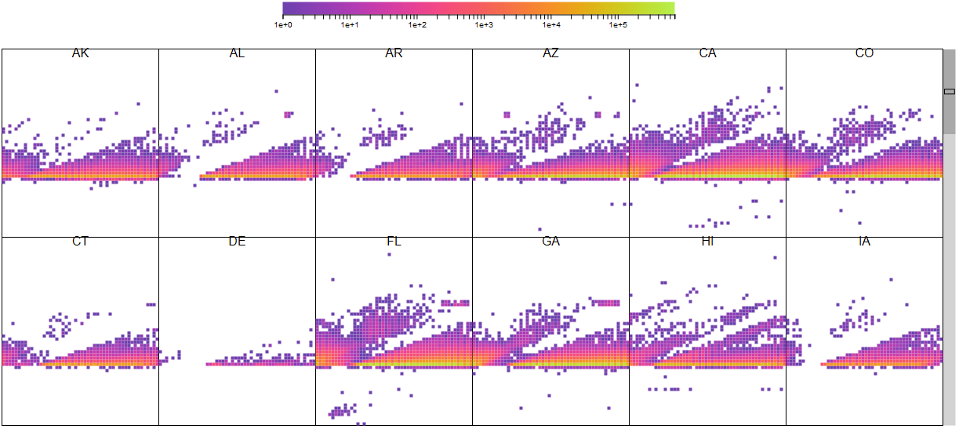
Trellis plots

Slide 45
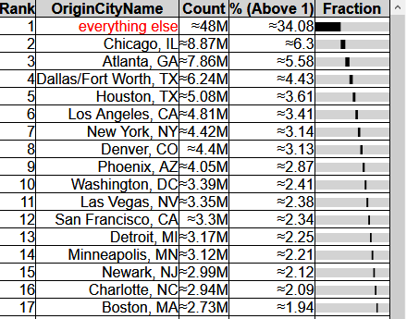
Frequent elements (heavy hitters)

Slide 46
All views are produced by vizketches!
Hypothesis: Vizketches are a sufficiently powerful computational model for visualization tasks.

Slide 47

Evaluation

Slide 48
Evaluation system
TOR switch
LAN
Web front-end
Root aggregator
Worker
8 servers
Intel Xeon Gold 5120 2.2GHz (2 sockets x 14 cores x 2 hyperthreads)
128GB RAM/machine
Ubuntu Server
10Gbps Ethernet in rack
2 SSDs/machine
client
…
Worker
Worker
rack

Slide 49
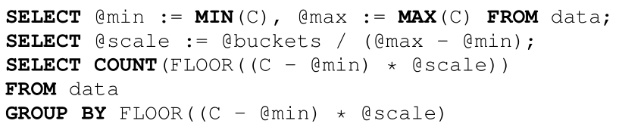
Comparison against database
Commercial database [can’t tell which one]
In-memory table
100M rows
DB takes 5,830ms (Hillview is 527ms)

Slide 50
Cluster-level weak scaling
Histogram, 100M elements/shard, 64 shards/machine
Computation gets faster as dataset size grows!

Slide 51
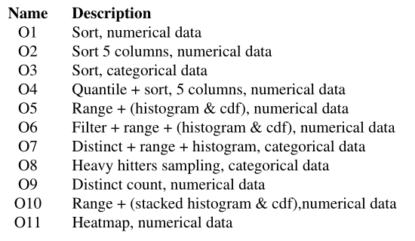
Comparison against Spark
5x the flights dataset (71B cells)
Spark times do not include UI rendering

Slide 52
Scaling data
5x | 71B cells
10x | 143B cells
100x | 1.43T cells
ORC data files, includes I/O and rendering

Slide 53
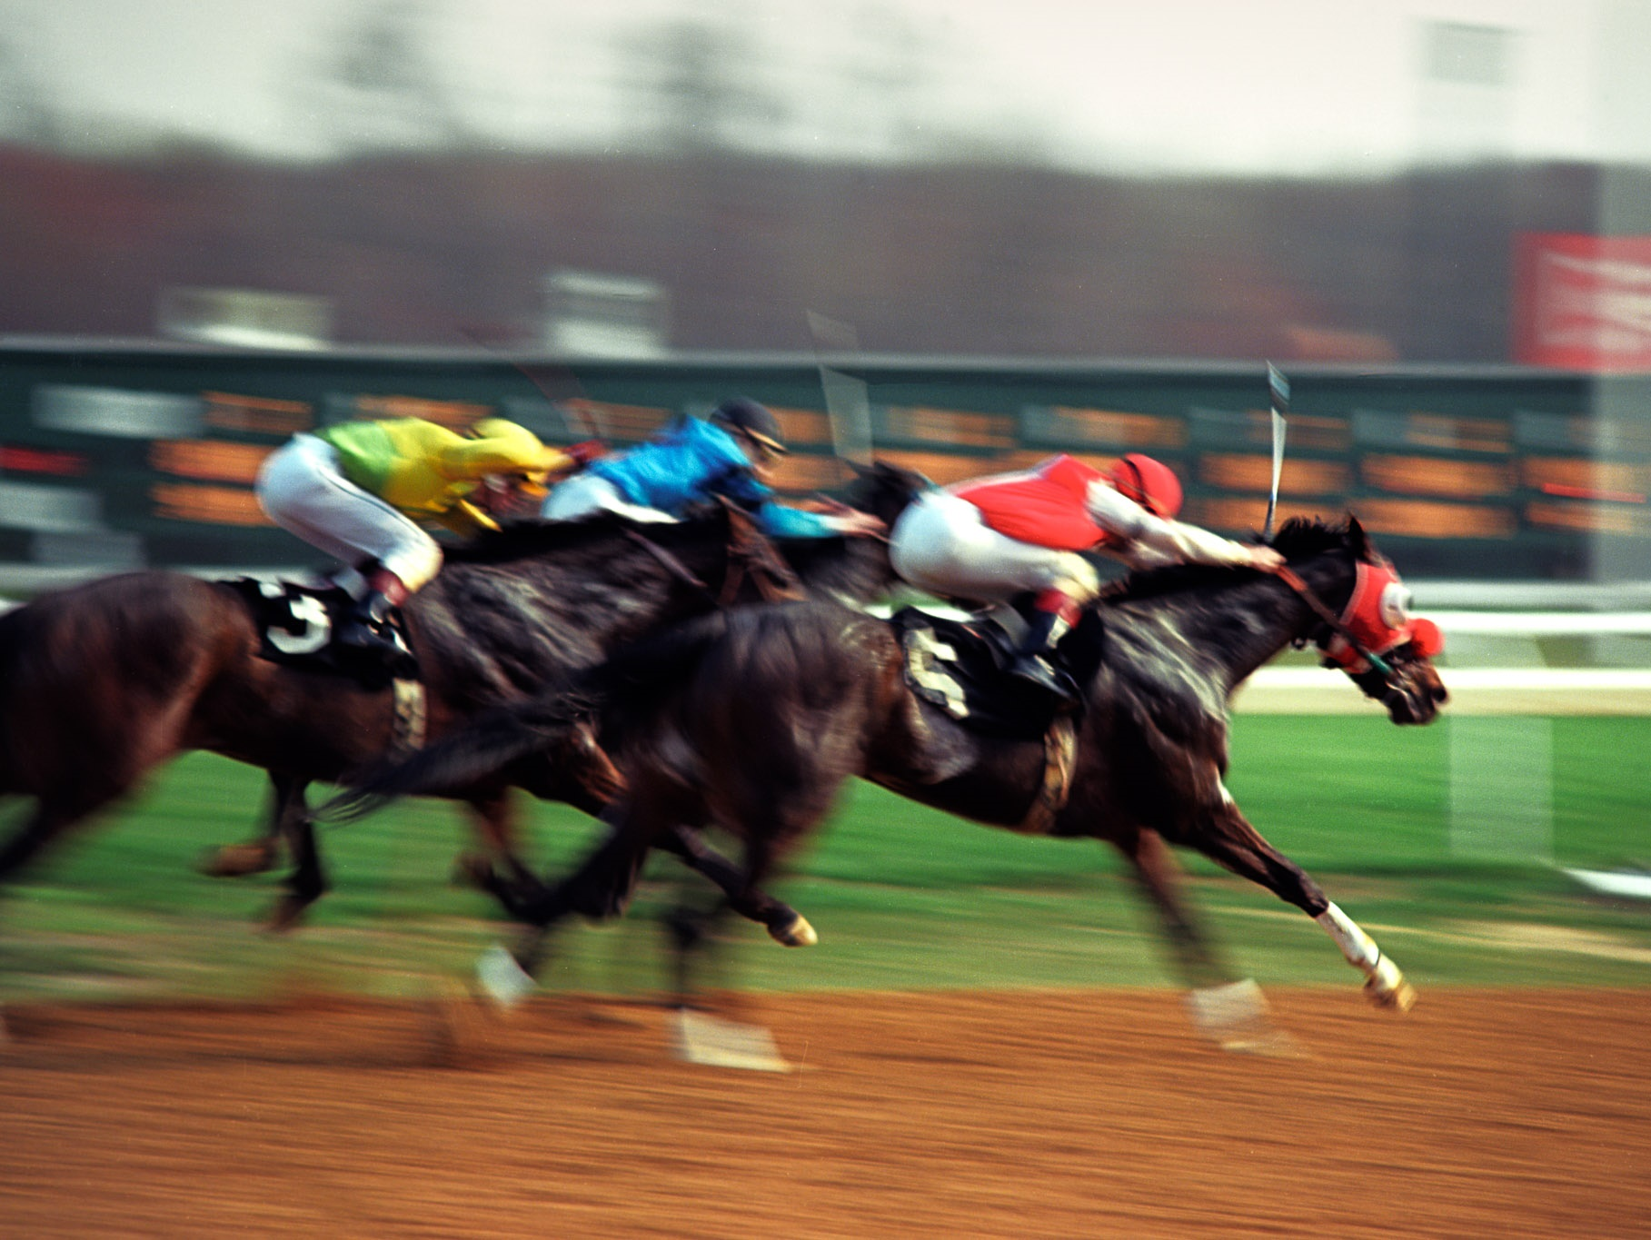
Conclusion

Slide 54
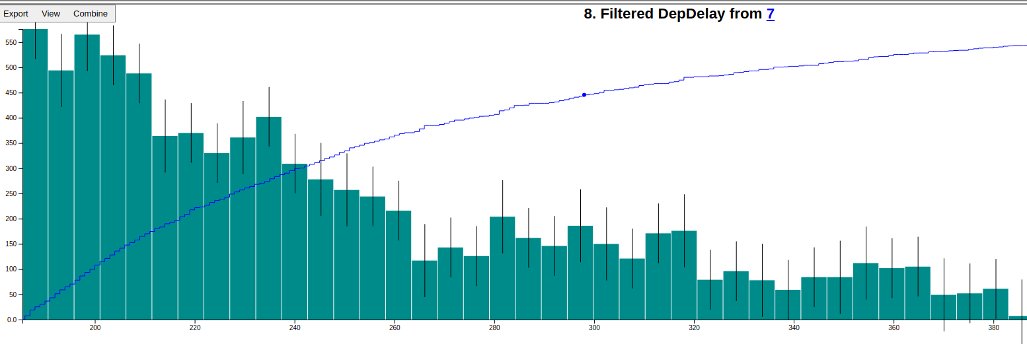
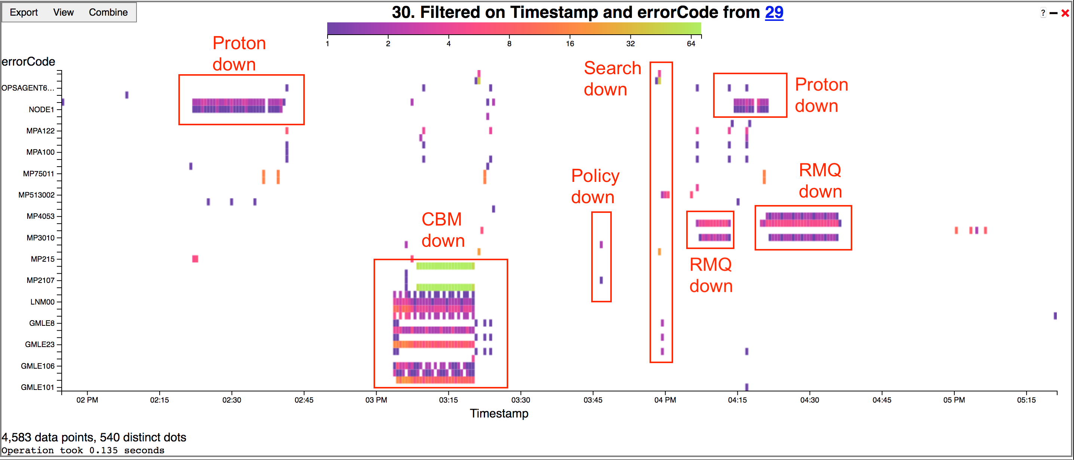
Future work
Differentially-private visualization (with Pratiksha Thaker, Matei Zaharia – Stanford)
Log analysis (with Hui Lyu, University of Pennsylvania)

Slide 55
Related work [a small sample]
Big data visualization
Databases, commercial products Polaris/Tableau, IBM BigSheets, inMens, Nanocubes, Hashedcubes, DICE, Erma, Pangloss, Profiler, Foresight, iSAX, M4, Vizdom, PowerBI
Big data analytics for visualization
MPI Reduce, Neptune, Splunk, MapReduce, Dremel/BigQuery, FB Scuba, Drill, Spark, Druid, Naiad, Algebird, Scope, ScalarR
Sampling-based analytics
BlinkDB, VisReduce, Sample+Seek, G-OLA
Incremental visualization
Online aggregation, progressive analytics, ProgressiVis, Tempe, Stat, SwiftTuna, MapReduce online, EARL, Now!, PIVE, DimXplorer

Slide 56

Lessons learned
vizketches: mergeable summaries
Linear or sublinear execution times
Small outputs (independent of input, function of screen size)
Efficient by construction
Efficiency enables interactivity
Efficiency of rendering is a first-class concern
Formulating the right queries is important
System is designed from the ground up for sampling
Define “approximately correct visualizations” precisely!
Small renderings make browser fast
Redo log => simple memory management

Slide 57
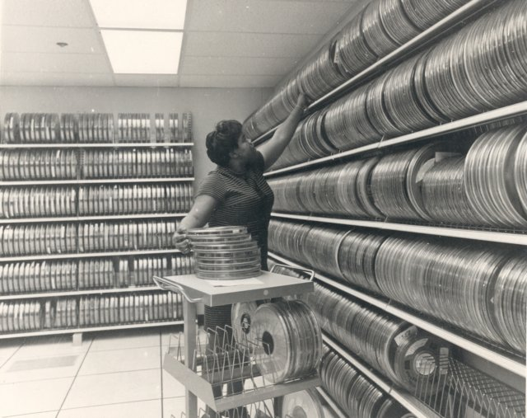
Backup slides

Slide 58

Linear transformations (homomorphisms)
Linear functions between monoids: f: M → N, f(a + b) = f(a) + f(b)
“Map”, “reduce”, “sketch” are linear functions
Linear transformations are the essence of data parallelism
Many streaming algorithms are linear transformations

Slide 59
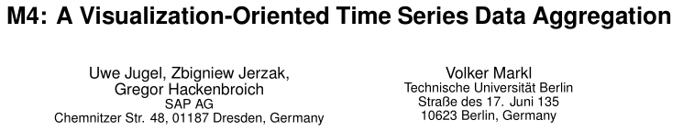
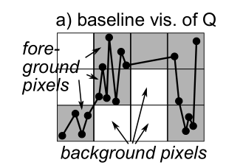
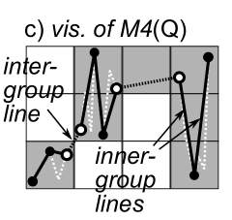
Pixel-level quantization

Slide 60

Reactive streams (RxJava)
interface Observable<T> { Subscription subscribe(Observer<T> observer); } interface Observer<T> { void onNext(T value); void onError(Throwable error); void onCompleted(); }
March 2012

Slide 61
Histogram execution timeline
Progress report
Render
User click
Data range
Initiate
histogram
Completed
Client
Web server
Data range
Histogram
+ CDF
Worker 1
Time
Compute
Worker n
Full scan
Sampled scan

Slide 62
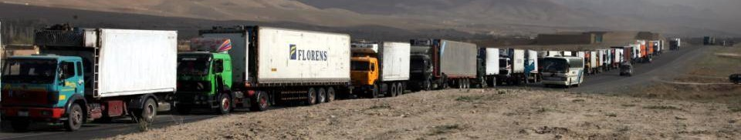
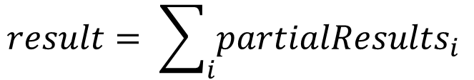
Observable roles (1)
Streaming data
Observable<R> partialResults;
$$result= \sum_{i}{{partialResults}_{i}}$$

Slide 63
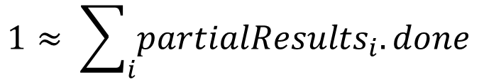
Observable roles (2)
Distributed progress reporting
class PR<T> { // A partial result double done; T data; }
Observable<PR<R>> partialResults;
$$1≈ \sum_{i}{{partialResults}_{i}.done}$$

Slide 64

Observable roles (3)
Distributed cancellation
Sketch API (C#)
async R map(Func<T, R> map, CancellationToken t, Progress<double> rep)
CancellationToken ct = cancellationTokenSource.token; Progress<double> reporter;
R result = data.map(f, ct, reporter); …
cancellationTokenSource.cancel();
Hillview API
Observable<PR<R>> map(Function<T, R> map);
Observable<PR<R>> o = data.map(f);
Subscription s = o.subscribe(observer);
…
s.unsubscribe();

Slide 65

Observable roles (4)
Concurrency management
Observable<T> data;
Observable<T> output = data.subscribeOn(scheduler);

Slide 66
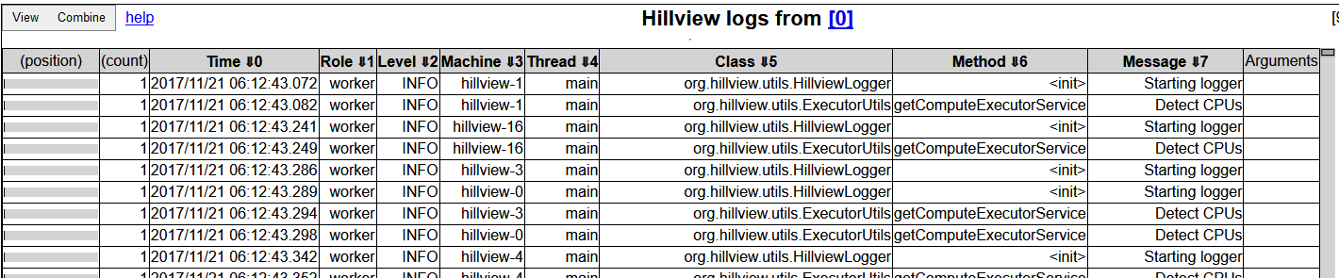
A log browser in Hillview
Spreadsheet
DataSet<Table>
Log parser
Distributed logs

Slide 67
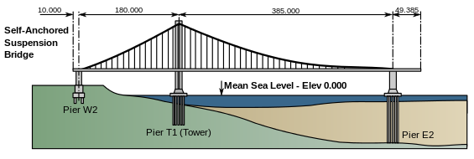
Hillview Design principles
Take display and perception limits into account
Wherever possible compute on sampled data
Compute views lazily (when users need them)
Shard data to exploit parallelism and increase responsiveness
Push computation to data
Only use sketching algorithms
Avoid hard state
Functional programming; immutable objects
Incremental view updates

Slide 68
zip
Remote
Remote
Remote
Parallel
Parallel
Parallel
Local
Local
Local
Local
Local
Local
T
T
S
S
T,S
T,S

Slide 69
Spreadsheet architecture
UI
Front-end
DataSet<Table>
Distributed objects
Table operations
Spreadsheet logic
SQL DB
CSV Files
Column store
…
Storage layer

Slide 70
Table data storage
Table₁
Table₂
Schema₁
Columns
Columns
Schema₂
Membership
set
Membership
set
Column
data

Slide 71

MembershipSet operations
Iterate
Sample
GetIteratorOverSample
Ideally cost should be O(|output|)
Union/intersection/etc.
Multiple implementations, depending on sparsity

Slide 72
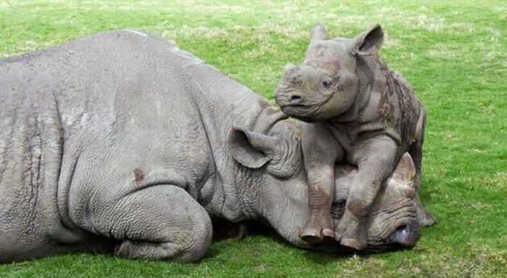
Scripting
We expose JavaScript to users
Create new columns
Write data filters
Oracle Java Nashorn JS engine

Slide 73
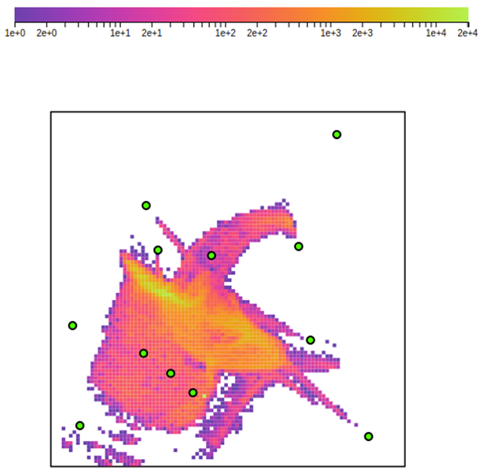
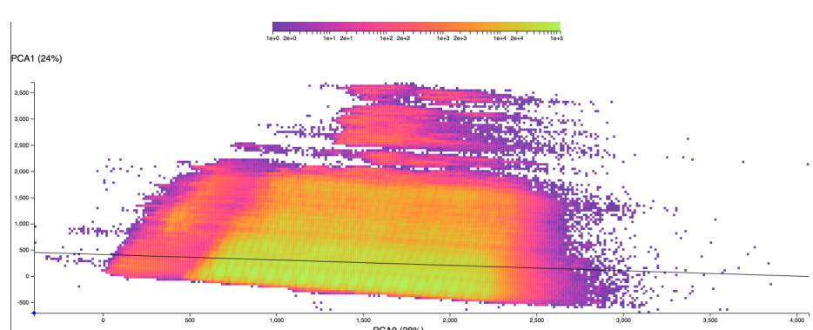
Dimensionality reduction
PCA
Covariance matrix computation is a sketch
Local Affine Multidimensional Scaling

Slide 74
Weak scaling - throughput

Slide 75
Service capacity

Slide 76
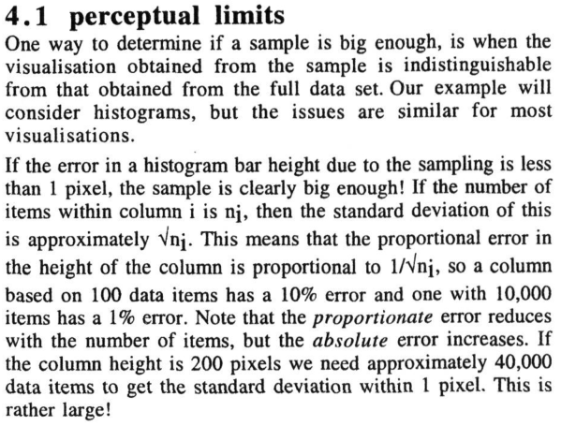

Approximate renderings

Slide 77
Sampling/Streaming for Databases/Visualization
Sampling to estimate the size of database queries. [Lipton-Naughton’89]
Streaming for estimating skew in databases [Alon-Matais-Szegedy’96]
Approximate renderings via sampling [Dix-Ellis’02]
Sampling to estimate relative orderings in renderings. [Kim-Blais-Parameswaran-Indyk-Madden-Runbinfeld’14]
Sampling to compute incremental renderings. [Rahman-Aliakbarpour-Kong-Blais-Karahalios-Parameswaran-Rubinfield’17]

Slide 78
Scrolling
aardvark
$h$ vertical pixels.
Each pixel represents a quantile.
Scrolling displays a screenful of consecutive records from this quantile.
earwig
….
ermine
zyzzyva

Slide 79
Scrolling
aardvark
$h$ vertical pixels.
Each pixel represents a quantile.
Step 1: Approximate quantile query: sampling ${O(h}^{2})$ elements suffices.
echidna
zyzzyva

Slide 80
Scrolling
aardvark
$h$ vertical pixels.
Each pixel represents a quantile.
Step 1: Approximate quantile query: sampling ${O(h}^{2})$ elements suffices.
Step 2: Given the top row, find the Next K in sorted order.
Sketch: single pass
Merge: mergeSort
echidna
echinoderm
ermine
zyzzyva

